Slide 1

Bright Coffee Shop Sales Analysis
Sebolelo Mary Moshe

Slide 2



Agenda
Which products generate the most revenue
What time of day the store performs best
Sales trends across products and time intervals
Recommendations for improving sales performance

Slide 3

Introduction
Business Insights for a New CEO using Historical Transactional Data from Bright Coffee Shop.

Slide 4
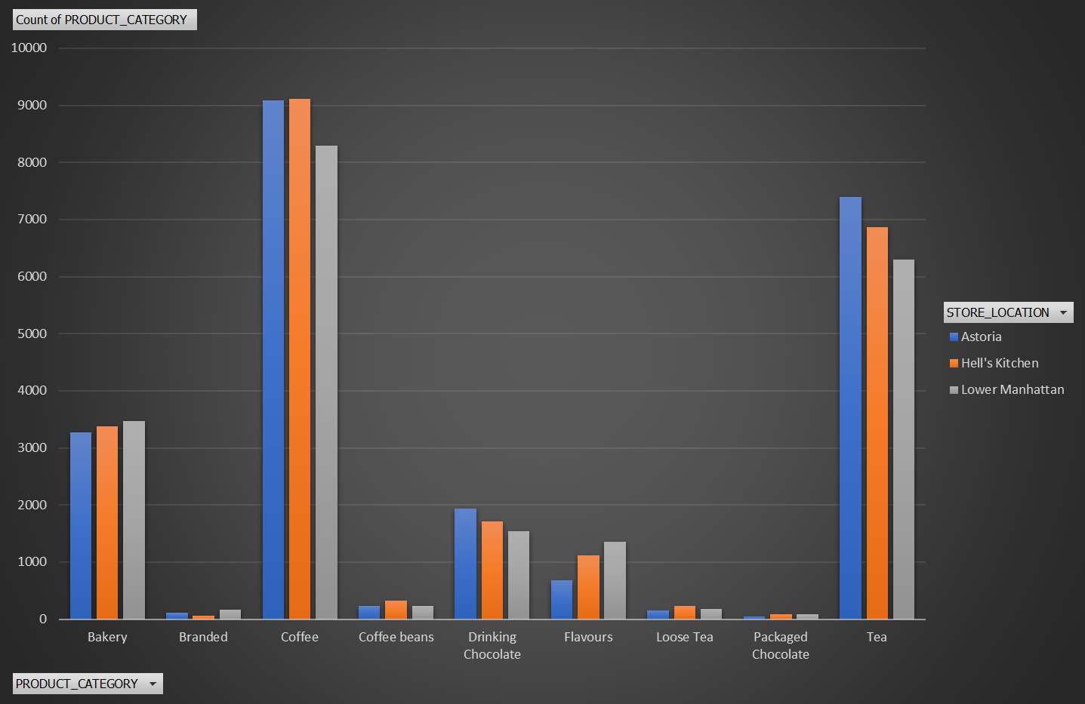
The Products That Generate The Most Revenue

Slide 5


The Products That Generate The Most Revenue
Coffee @ 26 485 (39%)
Tea @ 20 557 (31%)
Bakery @ 10 106 (15%)

Slide 6
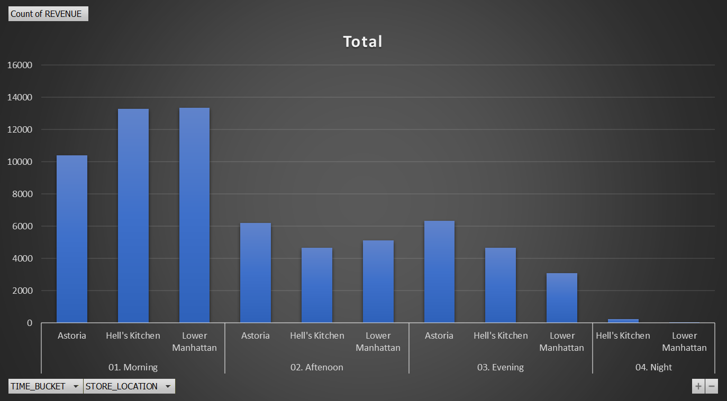
The Time Of Day The Company Performs Best
6

Slide 7
Sales Trends Across Products And Time Intervals

Slide 8

Summary
From the data analysis done:
Revenue is mostly attained mostly during week days and mostly in the morning hours.
Out of 3 shops Astoria shop is the main coffee shop bringing most revenue into the Bright Coffee Shop company.
The 3 main coffee products bring revenue:
Coffee @ 26 485
Tea @ 20 557
Bakery @ 10 106

Slide 9

Thank you
Sebolelo Mary Moshe
MSebolelo@gmail.com

